Slide 1
Scrum #2 FIND – Qurrat Ulain

Slide 2


Project Recap
This app aims to facilitate the process of finding missing people or those on the run from the police.
The app will have a knowledge aspect to it that will address some of the underlying themes and issues targeting vulnerable people in Regina such as poverty and racism.
This app focuses on promoting peace and inclusive societies for sustainable development and providing access to justice for all, following the 16th UN Sustainable Goal.

Slide 3
Emerging Technology Picture
The main selected community orientations for my project are content, individual participation and open-ended conversations.
The project will achieve community and technological integration by making it very accessible to the general user.
My main aim with this app in terms of polarities is to increase participation by including a centralized database that automatically updates, allowing users to spend time on more meaningful aspects of the app, such as the discussion board or articles.

Slide 4
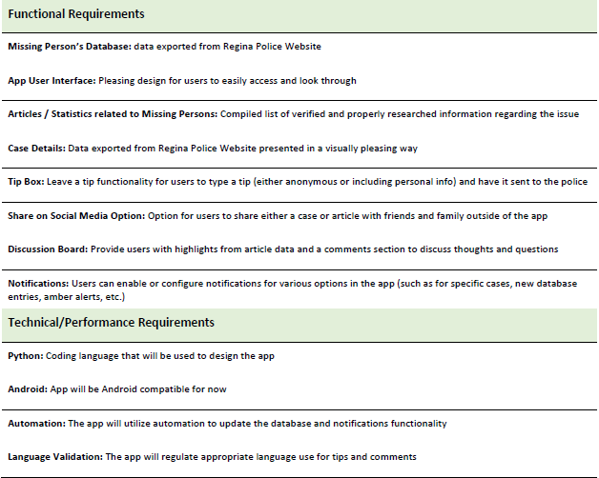
Project Scope and Requirements

Slide 5
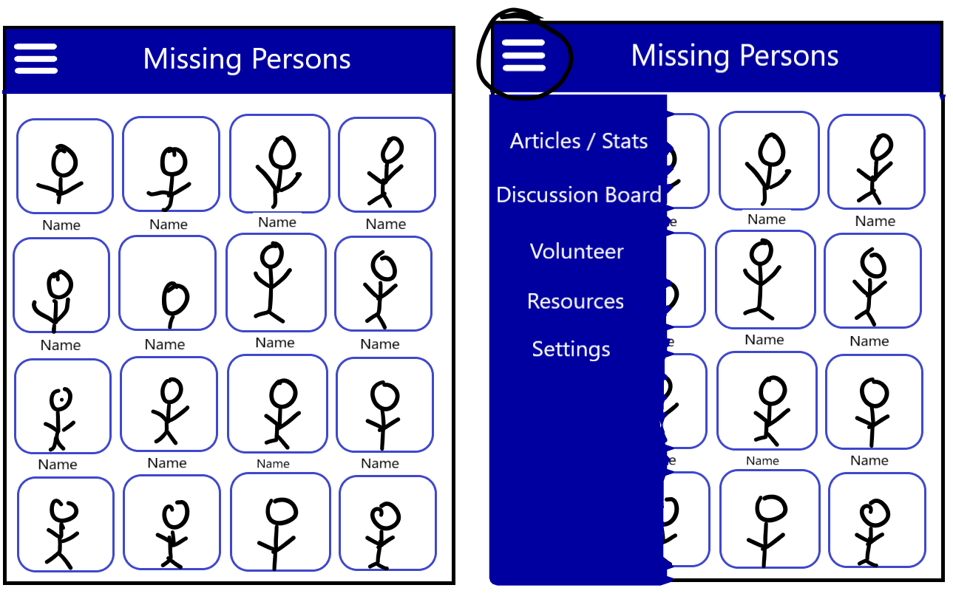
Low / Med Fidelity Prototypes

Slide 6
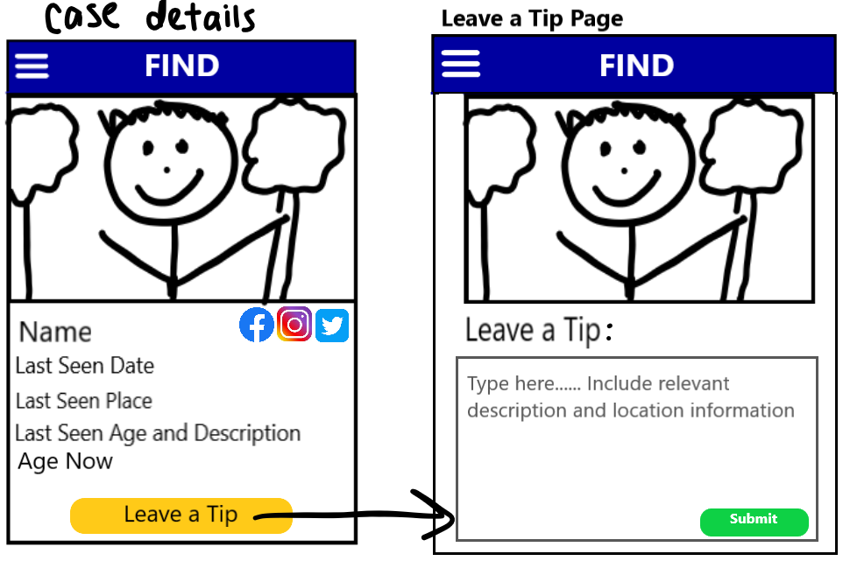

Slide 7
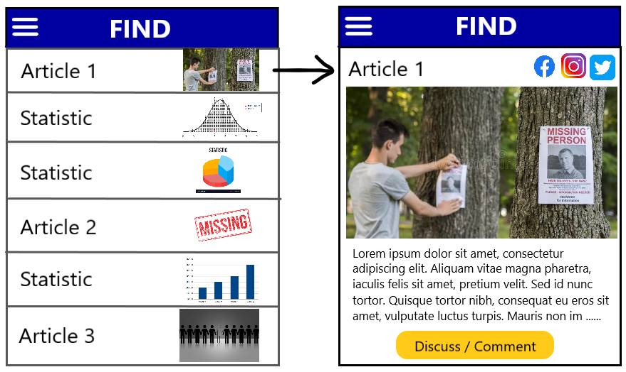

Slide 8
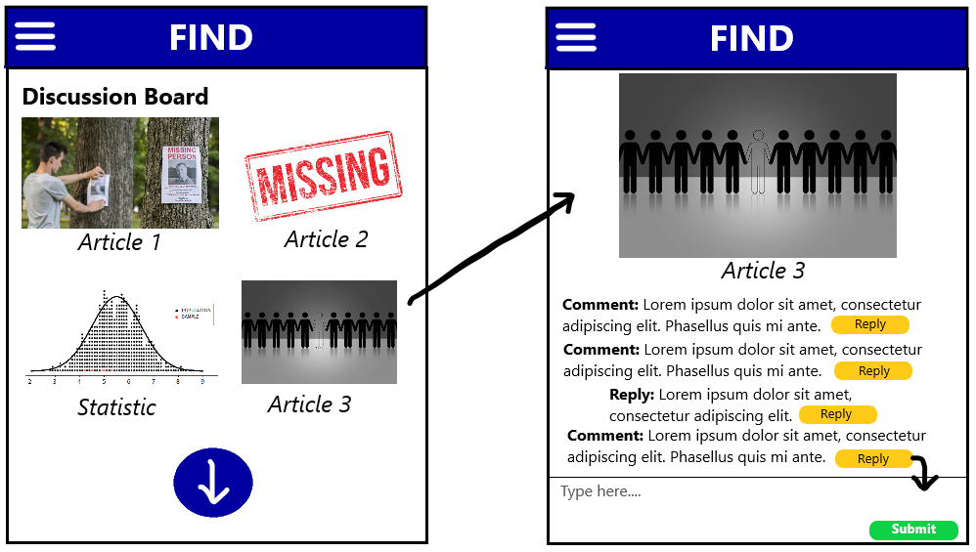

Slide 9
